Slide 1
Annalect (US) MMM framework
US Marketing Science Team

Slide 2
Wish list of the model platform
The design should be Intuitive and straightforward.
Reproducible : (past) model results (coefs, decomp, response curves, and ROI) can be easily reproduced.
Model/analysis can be easily communicated among team members -> improve collaborations and sharing of knowledge
Flexible :
Can be used across different clients and countries.
Model refresh with new data can be easily done with minor setups.
New functionality can be easily added into the existing structure of the platform.
Backward compatible
A frontend UI can be added easily if needed.
Modular:
The code should be written in an object-oriented way.
Each R function/module does one specific task. It should be written as generic as possible so that it can be easily used across different projects, and at different part of the model stage. For example, transform.R can be called pre-model stage and at the simulation stage.

Slide 3
Marketing Science MMM Platform (msmp) high level structure
Data
Model
Post Model
decomposition & unnest
Import data and taxonomy
transform
mod_obj
simulation (response curve)
optimization (channel planner)
(channel level) Bayesian Model (national or panel)
explore data analysis
mod_obj
tidy data
new planned data
Forecast/predict
A system/model object (a list object) is created at the very beginning;
It ties the whole work flow together.
At the end of the model, we should have a model object that has data, model specification, and coefficients, model fit, decomp, and response curvesetc.

Slide 4
Why Bayes?

Slide 5
Challenges in MMM
Classical regression works great with
Aggregated data
Data that has no serious multi-collinearity
The realities:
Multi-collinearity : TV and digital are excuted the same time -> unreliable and unstable estimates.
More granular estimates of marketing channels -> Degree of freedom -> too many predictors -> over-fitting and poor predictions
More granular estimates at regional level -> sparse data -> unreliable estimates
Model with short time period
Missing variable biases
Notes:
Data is messy : dis-aggregated, missing data, almost never come from a controlled randomized experiments.

Slide 6
How can we use Bayesian?
Bayesian framework allows incorporation of prior knowledge (from previous models, matched market test, domain experts knowledge, etc.).
We are allowed to incorporate prior information about the parameter, which is then updated by collected data… the posterior distribution (the result) from the previous model can then become prior for the next model… this process is just like human learning process -> far more intuitive.
The Bayesian framework fits marketing analytics much better :
Marketing managers (subject experts) usually have a sense of how marketing response are. This knowledge can be expressed in math form and incorporated into the model. If no prior information, the prior distribution can be expressed as a uniform distribution or a normal distribution with a huge variance.
Models are usually done semi-annually or annually, no need to start from scratch.
The essence of Bayesian statistics is the combination of information from multiple sources and fully accounting uncertainty using probability distributions and regularize estimations proportionally according to group-level and individual-level information – hierarchical Bayesian model.
Notes:
Data is messy : dis-aggregated, missing data, almost never come from a controlled randomized experiments.

Slide 7
FAQ : choice of prior
In the msmp framework, the prior of the model parameters are assumed to have gaussian distribution -> conjugate prior, Markov Chain Monte Carlo is not needed.
the default priors are diffuse/flat. In other words, normal distribution with mean of zero and standard deviation of 1 billion. The Bayesian regression result defaults to OLS result with such priors.
I recommend start with diffuse priors if you are building a model for a client/category for the first time.
Use informative priors (based on previous model results) during a model refresh.
If the data is panel style, geo or categories, hierarchical Bayesian model (partial pooling) can be built to account for
We have also split the variable (say total TV) to

Slide 8
The MMM R code framework
(msmp – marketing science model platform)
Notes:
Not a creative and exciting name. I am open for suggestions.

Slide 9
msmp R functions
The common R functions that can be used across clients/projects
Transform.R
Run_Model.R (runs myBayes.R – the Bayesian regression function)
Run_Model_Panel.R ( used for hierarchical Bayesian model)
Decomp.R
Unnestr.R
ResponseCurve.R
Etc.
Each function takes in a model object, picks what it needs, performs its functionality, updates and returns the object -> flexible and modular

Slide 10
MMM project (data and code) organization and workflow
Each model resides in a model folder. It contains
_ModelData.csv : model ready data file. The file should contain all the raw variables (depvar, potential independent variables, and time variables).
_ModelSetup.csv : model-level parameters. For example, log-log model, BeginDate, EndDate, etc.
_Variable.csv : model specification at variable level. List of variables in the model, how to transform them, etc.
_FitCurves.csv (optional) : reach curve data
A R code that sources all the common functions, reads in the input files, run the MMM model process and write out the results (coef, decomp, model object etc.)
This framework ensures model result reproducibility and documentation.
A frontend UI can be easily added to this framework.

Slide 11
An example

Slide 12
Bayesian Regression Model

Slide 13
Bayesian regression
The Model
or

Slide 14
Bayesian inference (1st step)
Priors
(assumption)
Notes:
A Bayesian will first write out his/her priors

Slide 15
Bayesian inference (2nd step)
Likelihood : a frequentist takes this step only
Notes:
The common step with the frequentist

Slide 16
Bayesian inference (the 3rd step)

Slide 17
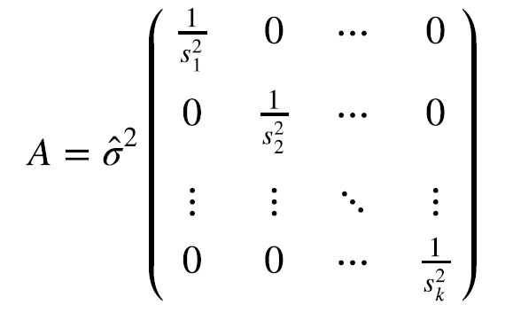
Calculate posterior without using MCMC
First estimate model error σ from data.
Then given the estimated σ, β can be calculated by augmenting data with prior, then estimating just like OLS.
It is much more robust, scalable, and fast.
Suitable for model with aggregated data, where model error can be assumed normally distributed.
Not suitable for individual-level data.
Notes:
This is math behind our implementation in Annalect R code.

Slide 18
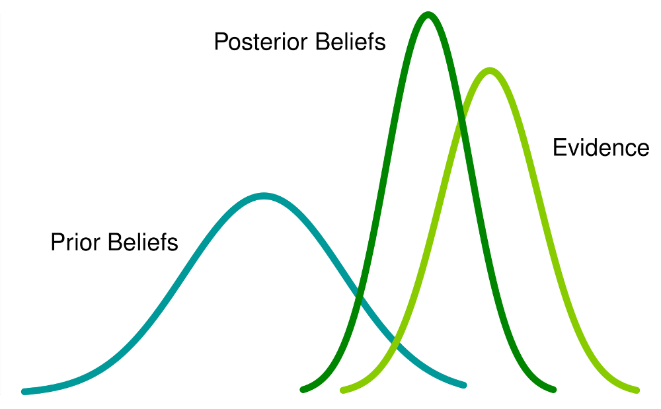
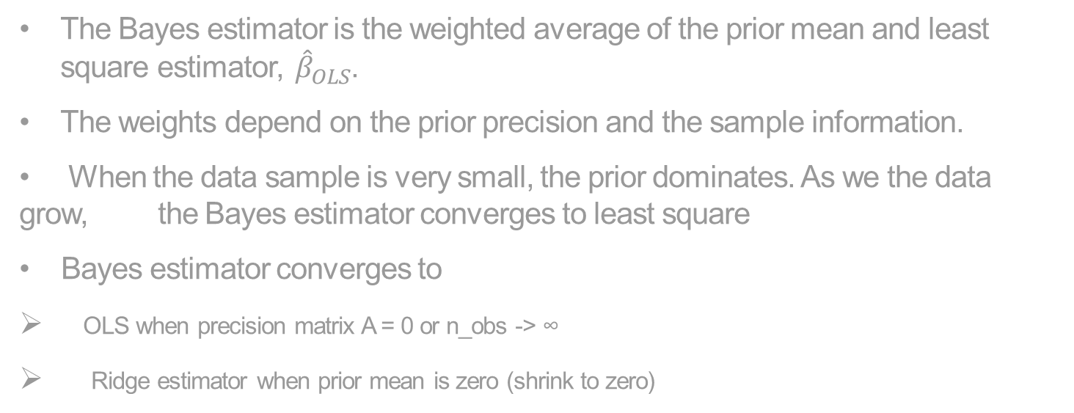

Bayesian regression estimator with conjugate priors
The Bayesian result of β is a Gaussian distribution with :
Mean:
Variance:
The Bayes estimator is the weighted average of the prior mean and least square estimator, ${\hat{β}}_{OLS}$.
The weights depend on the prior precision and the sample information.
When the data sample is very small, the prior dominates. As we the data grow, the Bayes estimator converges to least square
Bayes estimator converges to
OLS when precision matrix A = 0 or n_obs -> ∞
Ridge estimator when prior mean is zero (shrink to zero)
OLS estimator:
$${\left|\left|y −Xβ\right|\right|}^{2}$$
$$β_ols={\left(X^{′}X\right)}^{−1}X^{′}y$$

Slide 19
Bayes Theorem 101

Slide 20
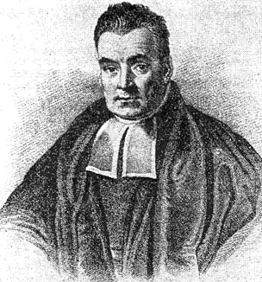
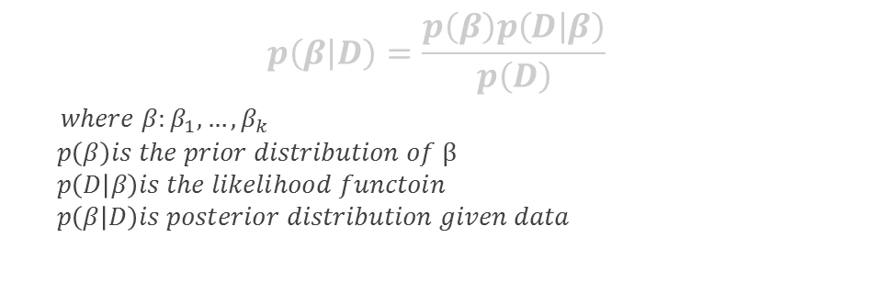
Bayesian theorem
“An Essay towards solving a problem in the doctrine of chances”
Bayes’ theorem: posterior ~ prior x likelihood
$$p\left(β | D\right)=\frac{p\left(β\right)p\left(D | β\right)}{p\left(D\right)}$$
$where β:β_{1},…,β_{k}$
$p\left(β\right)is the prior distribution of β$
$p\left(D | β\right)is the likelihood functoin$
$p\left(β | D\right)is posterior distribution given data$
Prior : a probability distribution over model parameter.
Update prior information in proportion to how well the data fits with that information
Posterior: a probability distribution of how plausible is beta at different values given data.
Notes:
Timeline :
Thomas Bayes (1701 – 1761).
The famous paper was brought to royal society’s attention 2 years after his death by Richard Price. The argument made by them is a statement, expressed both mathematically and philosophically – about how we learn about the univers : htat we learn about it through approximation, getting close and closer to the truth as we gather more evidence.
It was really put to use in the late 18th-century with the work of French mathematician and physicst Pierre-simon Laplace.

Slide 21
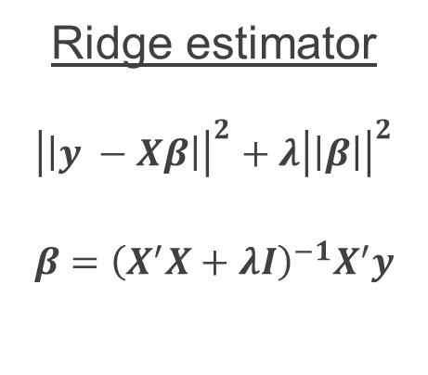
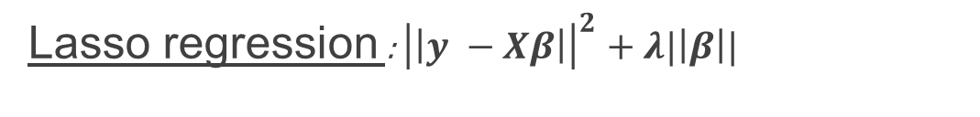
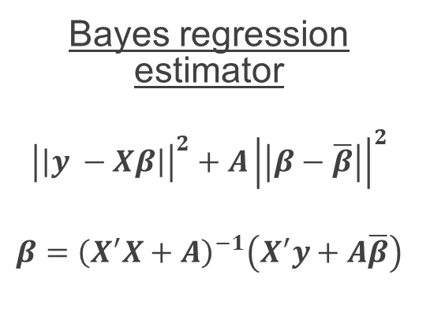
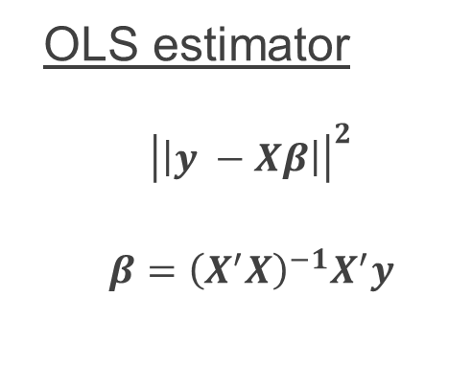
Connection to other (regularized/shrinkage) estimators
OLS estimator
$${\left|\left|y −Xβ\right|\right|}^{2}$$
$$β={\left(X^{′}X\right)}^{−1}X^{′}y$$
Ridge estimator
$${\left|\left|y −Xβ\right|\right|}^{2}+λ{\left|\left|β\right|\right|}^{2}$$
$$β={\left(X^{′}X+λI\right)}^{−1}X^{′}y$$
Bayes regression estimator
$${\left|\left|y −Xβ\right|\right|}^{2}+A{\left|\left|β−\overline{β}\right|\right|}^{2}$$
$$β={\left(X^{′}X+A\right)}^{−1}\left(X^{′}y+A\overline{β}\right)$$
Lasso regression : ${\left|\left|y −Xβ\right|\right|}^{2}+λ|\left|β\right||$
Stein estimator: same idea as empirical Bayes, where estimator for each individual unit is weighted average of grand mean and data of each individual. We will discuss empirical Bayes and hierarchal Bayes at another time.

Slide 22
The End
Thank you, and questions

